Slide 1
Week 10
Expectation-Maximization

Slide 2
Objectives
Describe the generative process for a mixture model
Explain the two basic steps in the EM algorithm.

Slide 3
Case Study
Product Manager:
“We have Summit coming up the week after next. One of the asks is that we present a view on who our users are. I would like to get a quantitative perspective on who our customers are, based on the entities they are searching for. I was thinking Kmeans…”

Slide 4
Problem Formulation
Always frame the problem as a scientific investigation
Need a testable hypothesis.
Hypothesis
Search users can be partitioned into a small number of clusters (<6), which help to explain, and provide additional insights about user behavior.

Slide 5
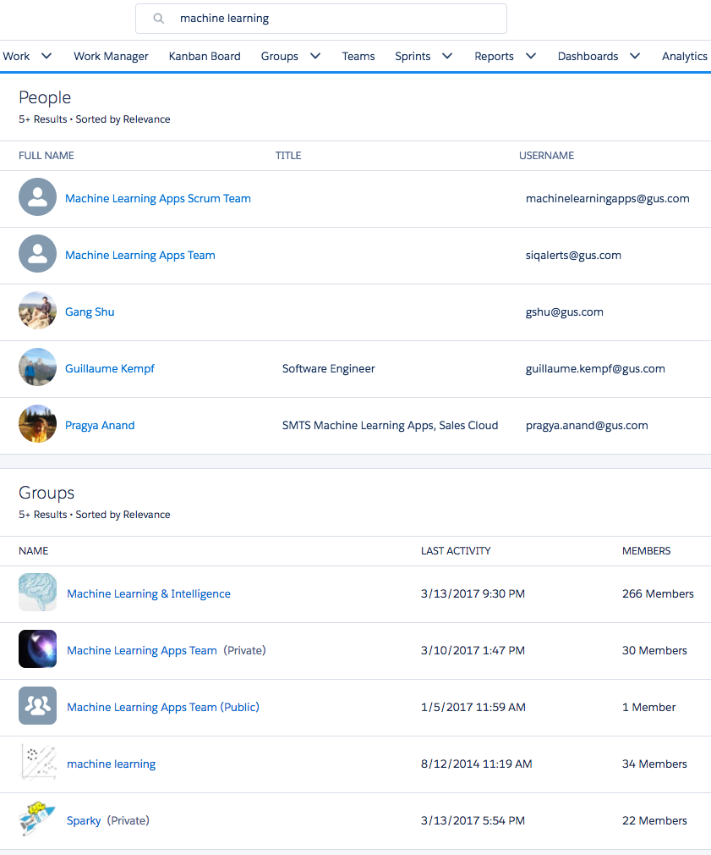
Search for machine learning.
Multiple different entities are returned.
We record which entity is clicked.

Slide 6
Data
Random sample of all users over a one week period.
For each user, record the number of clicks on each of the major entities.
User_id | Other | Account | Contact | Opportunity | Lead | Case | Custom | KnowledgeArticleVersion
1 | 2 | 8 | 0 | 2 | 2 | 1 | 18 | 0
2 | 9 | 0 | 0 | 0 | 0 | 109 | 0 | 4
3 | 20 | 0 | 0 | 0 | 0 | 0 | 2 | 2
4 | 0 | 2 | 0 | 1 | 0 | 0 | 2 | 0
5 | 1 | 0 | 0 | 12 | 0 | 0 | 0 | 0
6 | 0 | 0 | 0 | 0 | 0 | 0 | 2 | 0
7 | 0 | 48 | 12 | 0 | 2 | 0 | 0 | 0

Slide 7
Picking an algorithm
Which of these points should be considered ‘close’?
User_id | Other | Account | Contact | Opportunity | Lead | Case | Custom | KnowledgeArticleVersion
1 | 0 | 0 | 0 | 0 | 0 | 1 | 0 | 0
2 | 9 | 0 | 0 | 0 | 0 | 109 | 0 | 4
3 | 0 | 0 | 0 | 0 | 0 | 50 | 2 | 2
4 | 0 | 0 | 0 | 1 | 0 | 0 | 0 | 0
Using Euclidean distance, d(2, 3) > d(3, 4)
Using Cosine distance, d(1, 2) << d(1, 4)
Neither is a great solution..

Slide 8
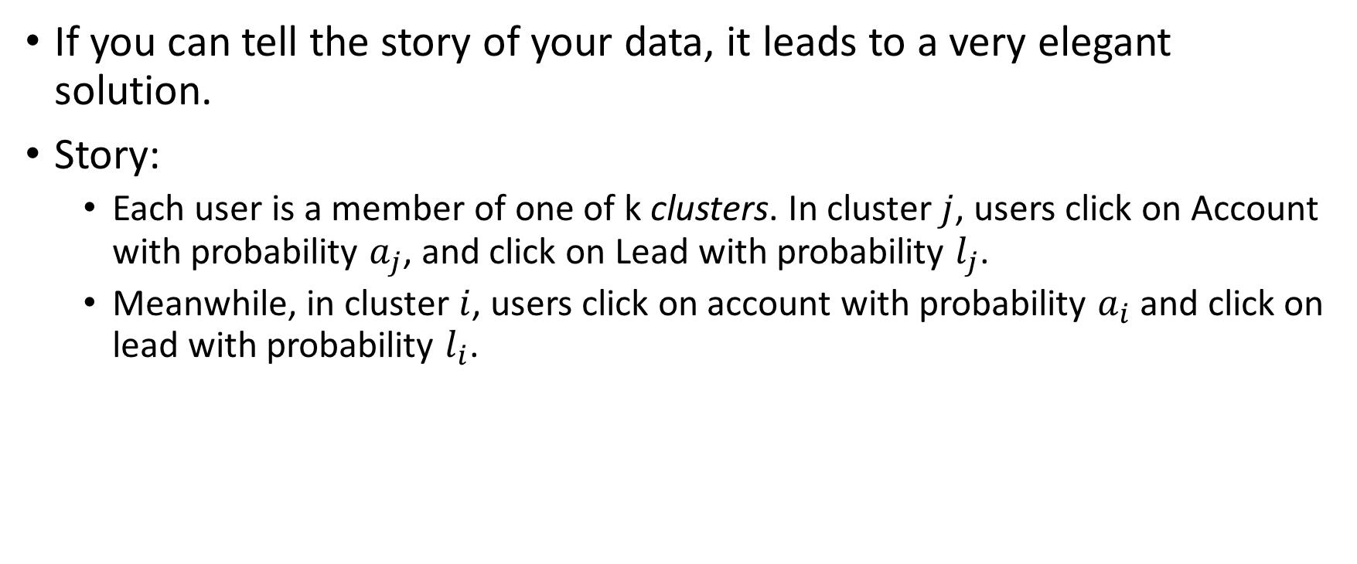
Generative Model for clicks
If you can tell the story of your data, it leads to a very elegant solution.
Story:
Each user is a member of one of k clusters. In cluster $j$, users click on Account with probability $a_{j}$, and click on Lead with probability $l_{j}$.
Meanwhile, in cluster $i$, users click on account with probability $a_{i}$ and click on lead with probability $l_{i}$.

Slide 9

Mixture of Multinomials
Say we have two clusters and two entities
Cluster A:
Prob = .4
Prob (Account, Lead) = (.8, .2)
Cluster B:
Prob = .6
Prob (Account, Lead) = (.4, .6)
To generate a click:
Choose which cluster the user belongs to, according to the probabilities for A and B.
Choose which entity was clicked according to the probabilities for that cluster
In this model, the probability of a click on an Account is: $(.4)(.8)+(.6)(.4)$

Slide 10
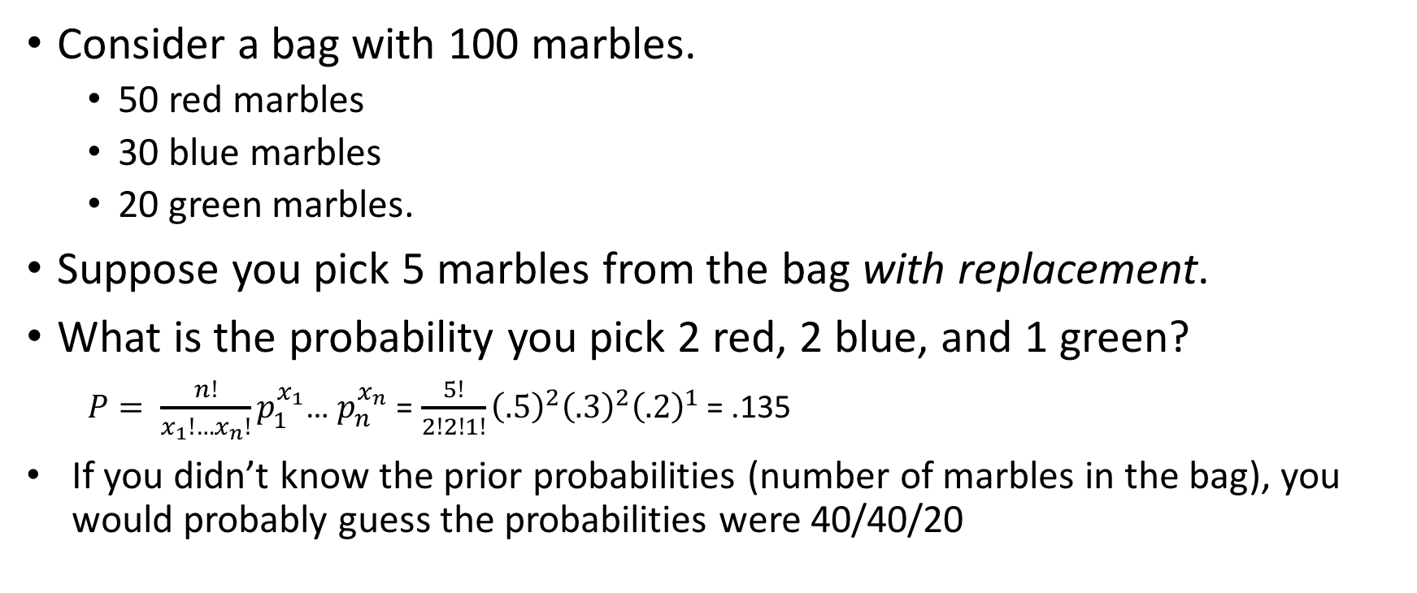
Multinomial Distribution
Consider a bag with 100 marbles.
50 red marbles
30 blue marbles
20 green marbles.
Suppose you pick 5 marbles from the bag with replacement.
What is the probability you pick 2 red, 2 blue, and 1 green?
$P= \frac{n!}{x_{1}!…x_{n}!}p_{1}^{x_{1}}$… $p_{n}^{x_{n}}$ = $\frac{5!}{2!2!1!}{\left(.5\right)}^{2}{\left(.3\right)}^{2}{\left(.2\right)}^{1}$ = .135
If you didn’t know the prior probabilities (number of marbles in the bag), you would probably guess the probabilities were 40/40/20

Slide 11
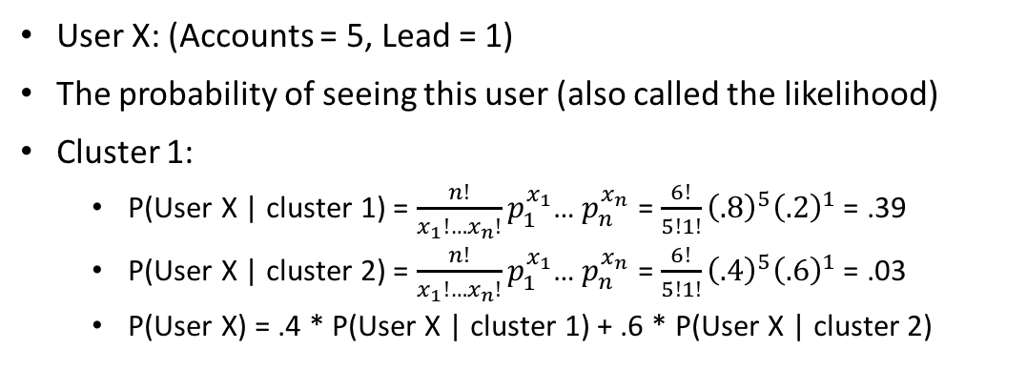
Probability of an observed data point
Model Parameters
User X: (Accounts = 5, Lead = 1)
The probability of seeing this user (also called the likelihood)
Cluster 1:
P(User X | cluster 1) = $\frac{n!}{x_{1}!…x_{n}!}p_{1}^{x_{1}}$… $p_{n}^{x_{n}}$ = $\frac{6!}{5!1!}{\left(.8\right)}^{5}{\left(.2\right)}^{1}$ = .39
P(User X | cluster 2) = $\frac{n!}{x_{1}!…x_{n}!}p_{1}^{x_{1}}$… $p_{n}^{x_{n}}$ = $\frac{6!}{5!1!}{\left(.4\right)}^{5}{\left(.6\right)}^{1}$ = .03
P(User X) = .4 * P(User X | cluster 1) + .6 * P(User X | cluster 2)
Cluster A:
Prob = .4
Prob (Account, Lead) = (.8, .2)
Cluster B:
Prob = .6
Prob (Account, Lead) = (.4, .6)
In order to fit a mixture model:
Pick a number of components
Find the model parameters that maximize the likelihood of the observed data.
Gradient Descent won’t work because of the ‘+’ sign in the likelihood function. That is why we use EM as an alternative to gradient descent.

Slide 12
Expectation-Maximization
K-Means
Take an initial guess for the cluster centers.
Calculate the distance from each point to the various cluster centers and use this to decide which cluster the point belongs to
Use the current cluster assignments to estimate the center of each cluster individually.
Repeat steps 2-3 until convergence
Initialize: Take initial guesses for the parameters (i.e. P(click on Account | cluster 1), etc…)
E-Step: Get the likelihood of each observed data point (user) and use this to decide which cluster the user is most likely to belong to.
M-Step: Use the current cluster assignments to estimate the click probabilites for each cluster individually.
Iterate: Repeat E-M steps until convergence.

Slide 13
Test the hypothesis
Fit a Multinomial Mixture model for a range of numbers of clusters.
Observe likelihood and BIC to see if a small number of clusters makes sense.
Interpret clusters and verify that they show expected structure.
See if it is possible to derive new insights from the cluster structure.
Hypothesis
Search users can be partitioned into a small number of clusters (<6), which help to explain, and provide additional insights about user behavior.

Slide 14
Likelihood
More clusters will always increase the overall likelihood.
The ‘elbow’ at either 4 or 6 clusters indicates diminishing returns as you add more clusters.
Since the hypothesis was <6 clusters, let’s evaluate the 4 cluster model.

Slide 15
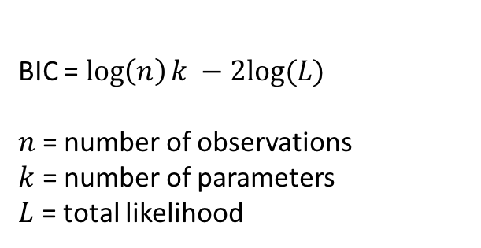
Bayesian Information Criterion (BIC)
BIC = $\log\left(n\right)k −2log⁡(L)$
$n$ = number of observations
$k$ = number of parameters
$L$ = total likelihood
BIC takes into account the number of data points and number of parameters to help avoid overfitting.
Assuming some conditions are met, the best model has the lowest BIC.
Conclusion: A low dimensional representation of user clicks does not capture all of the complexity present. We can still proceed, knowing that the 4 clusters are gross oversimplifications.

Slide 16
Cluster Descriptions
A: Accounts, Contacts, Other
B: Custom Objects
C: Sales
D: Service
Opportunities and Leads (both sales objects) are used by the same type of users.
Cluster A is probably just ‘the rest’
Users that use custom entities tend to use them almost exclusively.

Slide 17
Cluster Descriptions
Sales users are the most likely to also use custom objects.
Knowledge articles are used about equally by service workers and ’others’.

Slide 18
Click Frequencies
 | p10 | p25 | p50 | p90 | p99
Accounts, Contacts, Other | 1 | 2 | 6 | 63 | 262.00
Custom Objects | 1 | 4 | 16 | 167 | 824.08
Sales | 1 | 3 | 8 | 61 | 365.77
Service | 2 | 6 | 20 | 108 | 386.00
The highest search volumes by user tend to come from users that use service or custom entities.

Slide 19
Conclusion
Hypothesis is true. There is some insight we can gain from a low-dimensional clustering of search users.
Next steps:
What is the optimal representation according to BIC? Does this add anything?
Can this clustering be used to improve search? For example, customized ranking by user type?

